Slide 1
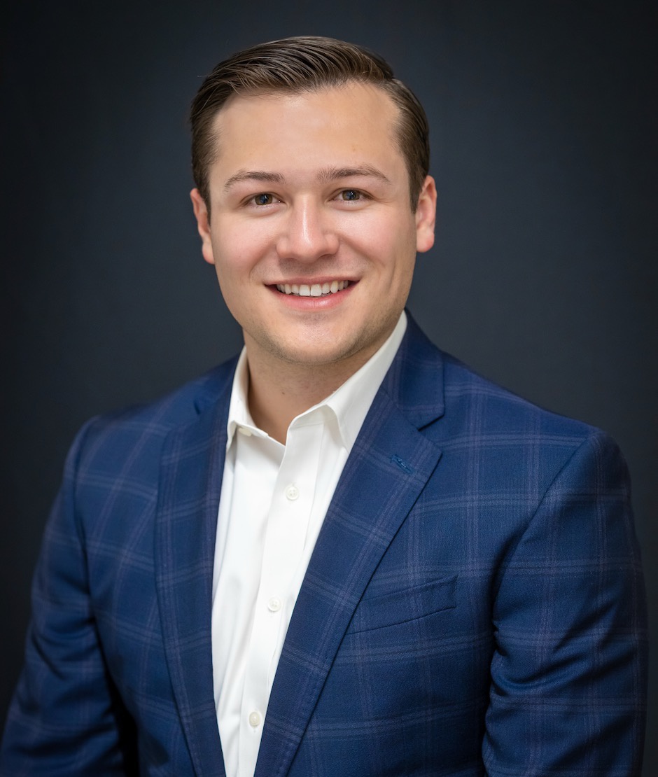
Jake Varra Manager — Experiences
Email
jake.varra@thebridge.com
Location
Dallas, Texas
Mobile
(720) 984-3768
Jake joined The Bridge in April 2024. He previously worked at several consulting firms (both small and large), where he gained a broad set of experiences centered on business transformation. His specialty is helping leaders to harmonize the design of their experiences, operating models, and organizations in order to holistically achieve their goals.
EXPERIENCE
Industry Experience
Oil & Gas (Midstream) | Electric Utility | Automotive | Healthcare | Life Sciences | Manufacturing | Media
Customer Journey Redesign | Employment Technology
Facilitated 30+ experience design workshops to define the current and ideal customer journey and underlying business processes of a global, multibillion-dollar unicorn start-up spanning six different service lines, including two recently acquired businesses.
Portfolio Optimization & Model Design | Healthcare Marketing
Supported a marketing portfolio rationalization for a leading children’s hospital, developing and applying a customized agency partner evaluation methodology and scorecard aligned with the team's values and strategy. This enabled the modeling of an optimized future state portfolio, prioritizing organizational effectiveness and cost reduction.
Planned and led a marketing portfolio restructuring event, addressing agency partner performance challenges and operational inefficiencies (liberated over 55% of portfolio funds for reallocation to higher-performing partners and new marketing capabilities).
Organization Development | Oil & Gas
Conducted a review and redesign of the Technology organization at a leading U.S. Pipeline company, collaborating with the CEO, CTO, and CHRO to define the organizational strategy, identify capability gaps, establish/realign the necessary verticals and teams, and assess and select talent for all newly designed or modified roles
Developed a comprehensive framework to standardize the levels and titles of managerial roles across the enterprise based on work complexity, discretionary limits, and skill/knowledge requirements.
BACKGROUND
Functional Skills
Workshop Design & Facilitation, Change Management, Strategic Communications, Organizational Development (OD) & Effectiveness (OE), Strategic Visioning, Strategic Program Planning, Executive Alignment
Qualifications
A consulting Manager specializing in experience design. While focused on highly strategic engagements, Jake has led several transformative programs in recent years, including a complete enterprise reorg, an IoT business model conversion to SaaS, and the establishment of a CoE operating model for a Healthcare Marketing department.

Slide 2

Email
Jake.varra@thebridge.com
Location
Dallas, Texas
Mobile
(720) 984-3768
Jake joined The Bridge in April 2024. He previously worked at several consulting firms (both small and large), where he gained a broad set of experiences centered on business transformation. His specialty is helping leaders to harmonize the design of their experiences, operating models, and organizations in order to holistically achieve their goals.
Jake Varra Manager
Experiences

Slide 3
Jake Varra Manager — Experiences
Email
Jake.varra@thebridge.com
Mobile
(720) 984-3768
Location
Dallas, Texas
BACKGROUND
EXPERIENCE
Functional Skills
Workshop Design & Facilitation, Change Management, Strategic Communications, Organizational Development (OD) & Effectiveness (OE), Strategic Visioning, Strategic Program Planning, Executive Alignment
Qualifications
A consulting Manager specializing in experience design. While focused on highly strategic engagements, Jake has led several transformative programs in recent years, including a complete enterprise reorg, an IoT business model conversion to SaaS, and the establishment of a CoE operating model for a Healthcare Marketing department.
Industry Experience
Oil & Gas (Midstream) | Electric Utility | Automotive | Healthcare | Life Sciences | Manufacturing | Media
Customer Journey Redesign | Employment Technology
Facilitated 30+ experience design workshops to define the current and ideal customer journey and underlying business processes of a global, multibillion-dollar unicorn start-up spanning six different service lines, including two recently acquired businesses.
Portfolio Optimization & Model Design | Healthcare Marketing
Supported a marketing portfolio rationalization for a leading children’s hospital, developing and applying a customized agency partner evaluation methodology and scorecard aligned with the team's values and strategy. This enabled the modeling of an optimized future state portfolio, prioritizing organizational effectiveness and cost reduction.
Led the marketing portfolio restructuring project, addressing agency partner performance challenges and operational inefficiencies (Liberated over 55% of portfolio funds for reallocation to higher-performing partners and new marketing capabilities).
Organization Development | Oil & Gas
Conducted a review and redesign of the Technology organization at a leading U.S. Pipeline company, collaborating with the CEO, CTO, and CHRO to define the organizational strategy, identify capability gaps, establish/realign the necessary verticals and teams, and assess and select talent for all newly created or modified roles
Developed a comprehensive framework to standardize the levels and titles of managerial roles across the enterprise based on work complexity, discretionary limits, and skill/knowledge requirements.

Slide 4
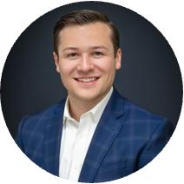
MEET THE REPRESENTATIVE TEAM
RELEVANT EXPERIENCE
Velocity Global
Facilitated 30+ experience design workshops to define the current and ideal customer journey and underlying business processes of a global, multibillion-dollar unicorn start-up.
Jake Varra Manager, Experiences
Digi International Established transformation approach for a global IoT company transitioning to a SaaS + Hardware model, aligning leaders on marketplace solutions, innovating a low-friction customer identification process, and rapidly prototyping
Colonial Pipeline
Conducted a review and redesign of the Tech Org collaborating across the c-suite to define the organizational strategy, identify capability gaps, establish new teams, and assess and select talent for newly designed roles.
ABOUT JAKE
Jake combines a strategic mindset with hands-on expertise in experience design, driving innovation and transformation across industries.
Throughout his management consulting career, he has orchestrated a complete enterprise reorganization, spearheaded an IoT business model's evolution into SaaS, and established a Center of Excellence (CoE) operating model for a Healthcare Marketing department. Through all his work, Jake brings experience design to the forefront, ensuring that every initiative harmonizes user expectations with business outcomes.
INDUSTRIES
Oil & Gas (Midstream), Electric Utility, Automotive, Healthcare, Life Sciences, Manufacturing, Media, Professional Services
SKILLS
Workshop Design & Facilitation, Change Management, Strategic Communications, Organizational Development (OD) & Effectiveness (OE), Strategic Visioning, Strategic Program Planning, Executive Alignment

